Slide 1
Daffodil International Professional Training Institute
Lead Trainer: Rajesh Kumar Das
Assistant Trainer: Mr. Shakil
Group name: Di-Tech Squad

Slide 2
Project IDEA and discussion!
Project name: _ InstaCore _
Institute Management System

Slide 3
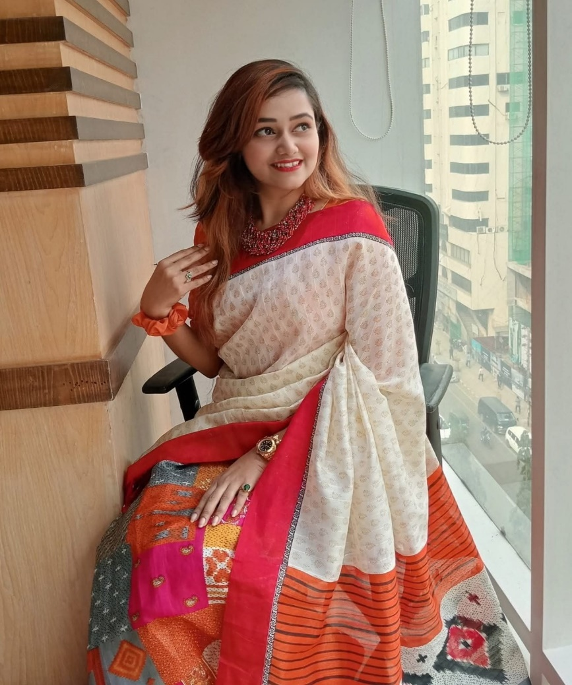
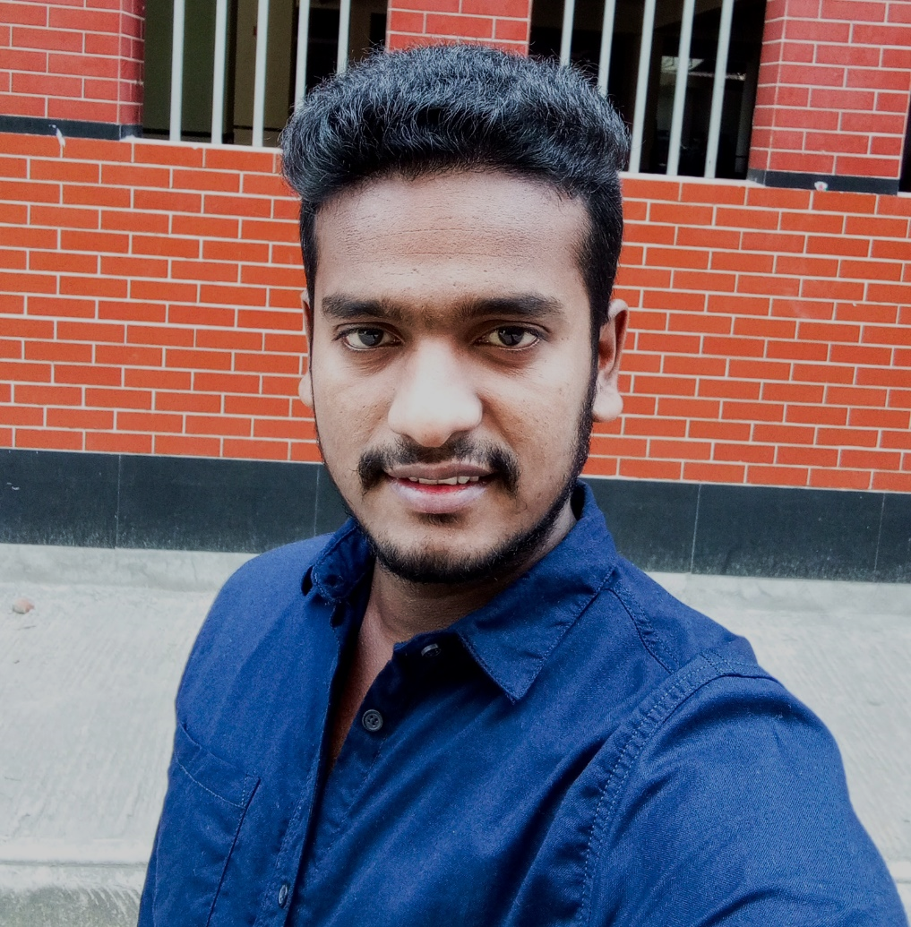
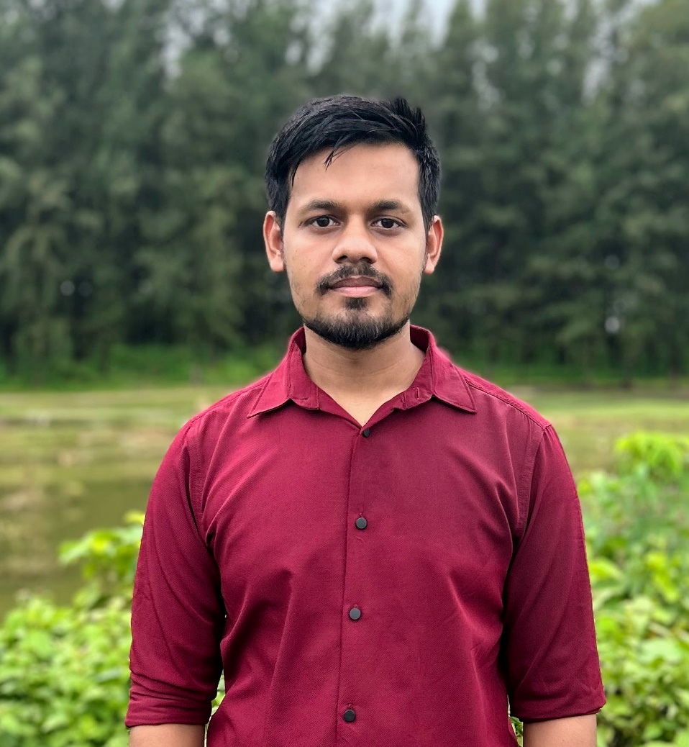
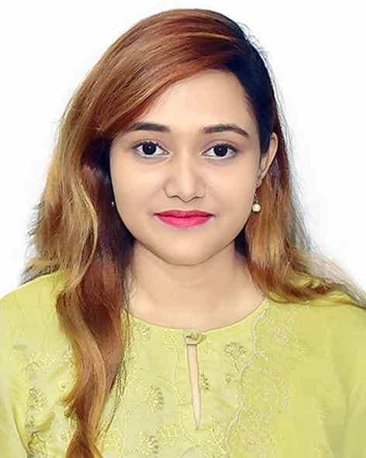
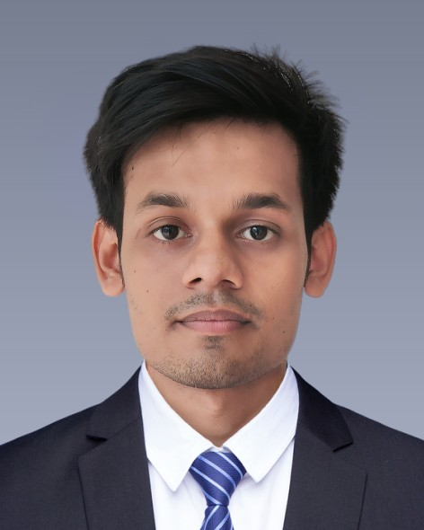
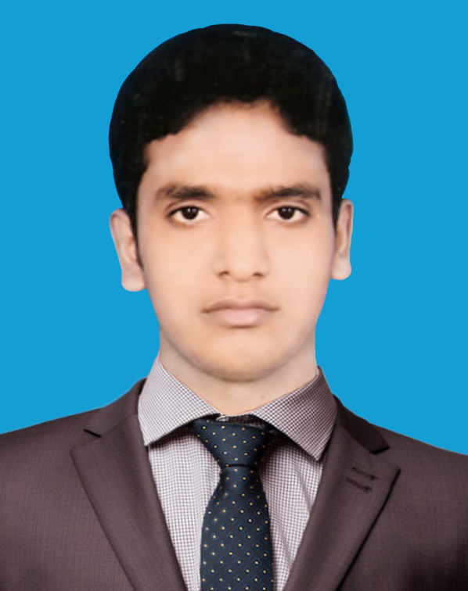
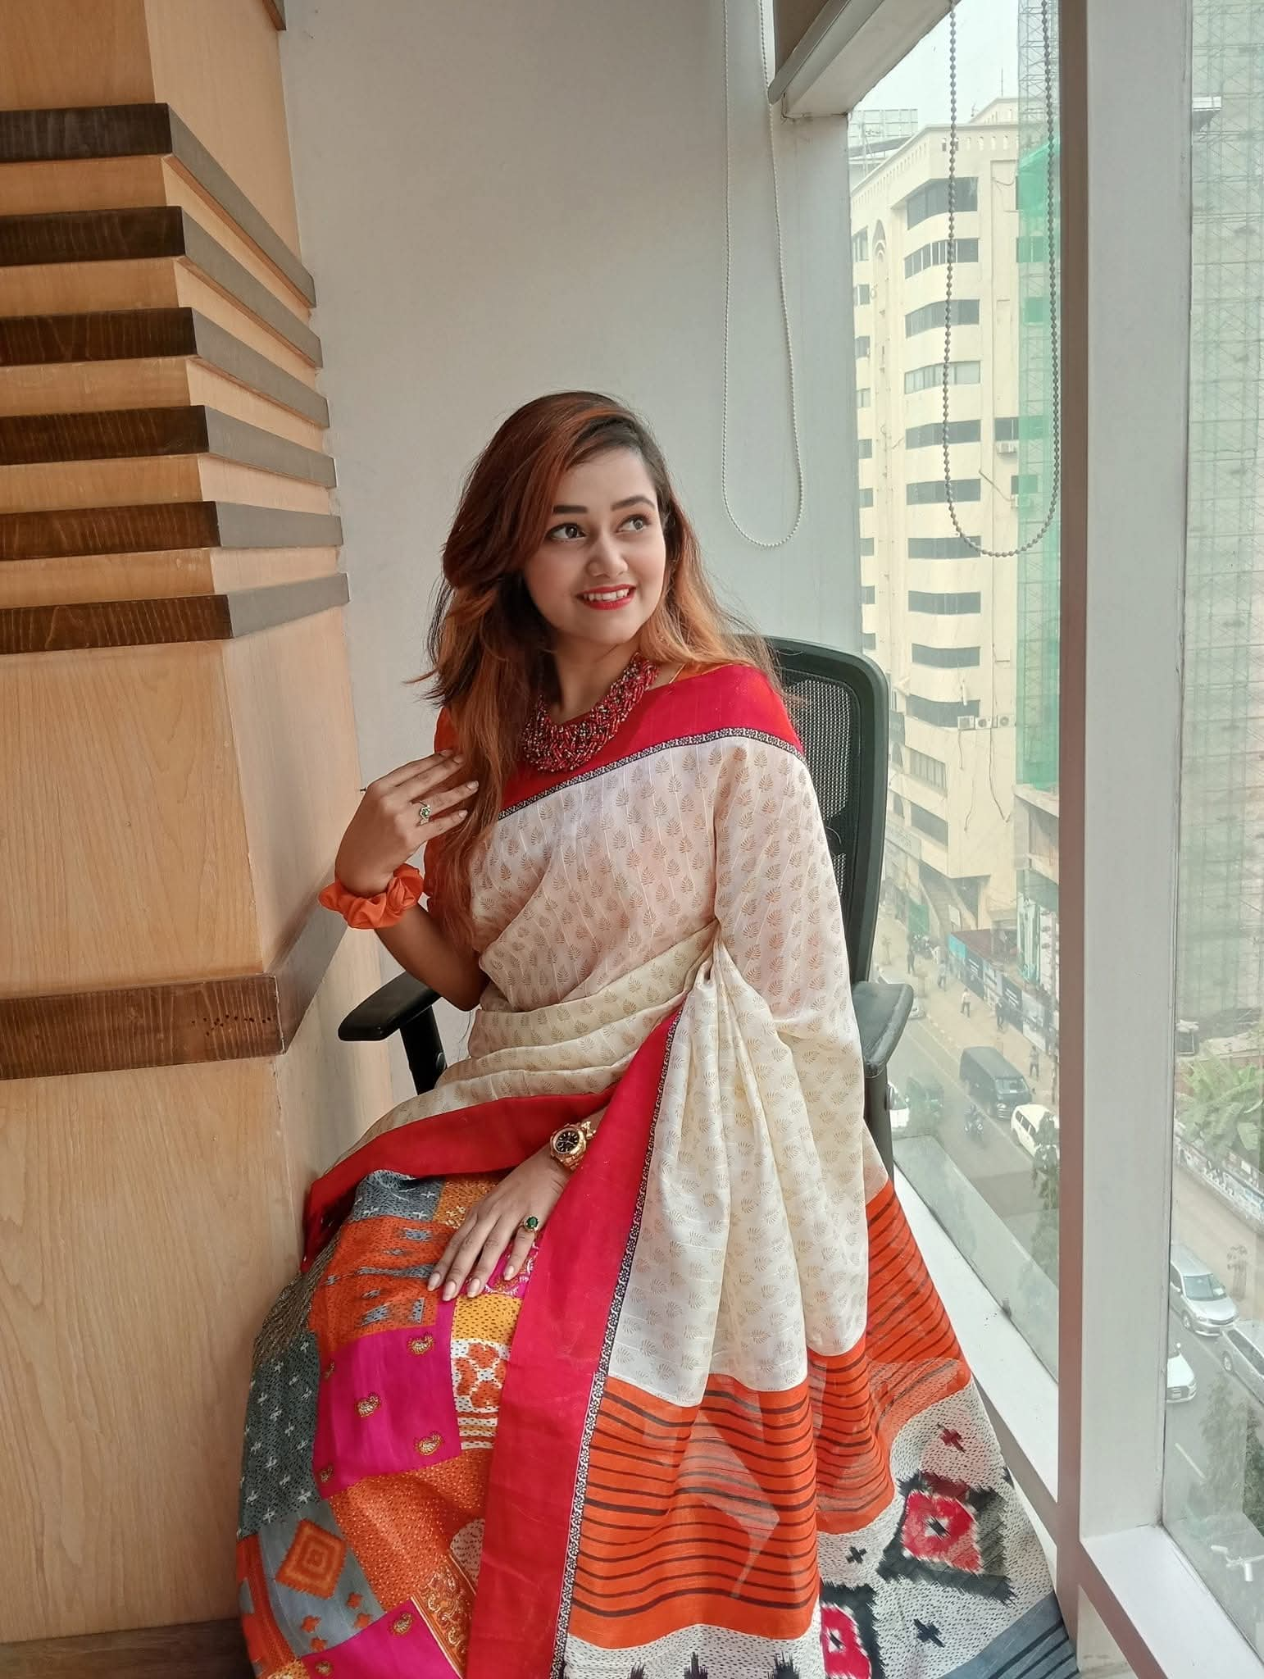
MEET OUR TEAM
Humaira Akter
Mehedi Alam
Khalid Mahmud
Design & UI/UX
Full-stack Support
Back-end & APIs

Slide 4
What is InstaCore?
Web-based platform for institute management
Modern, secure, and responsive
Solves problems in outdated systems

Slide 5
Features – Phase 1
Landing page with login & signup
Custom Django authentication
Email verification for signup
OTP verification before account deletion
Individual user dashboards
Profile management (edit, password, delete)
Role-aware navigation bar and footer

Slide 6
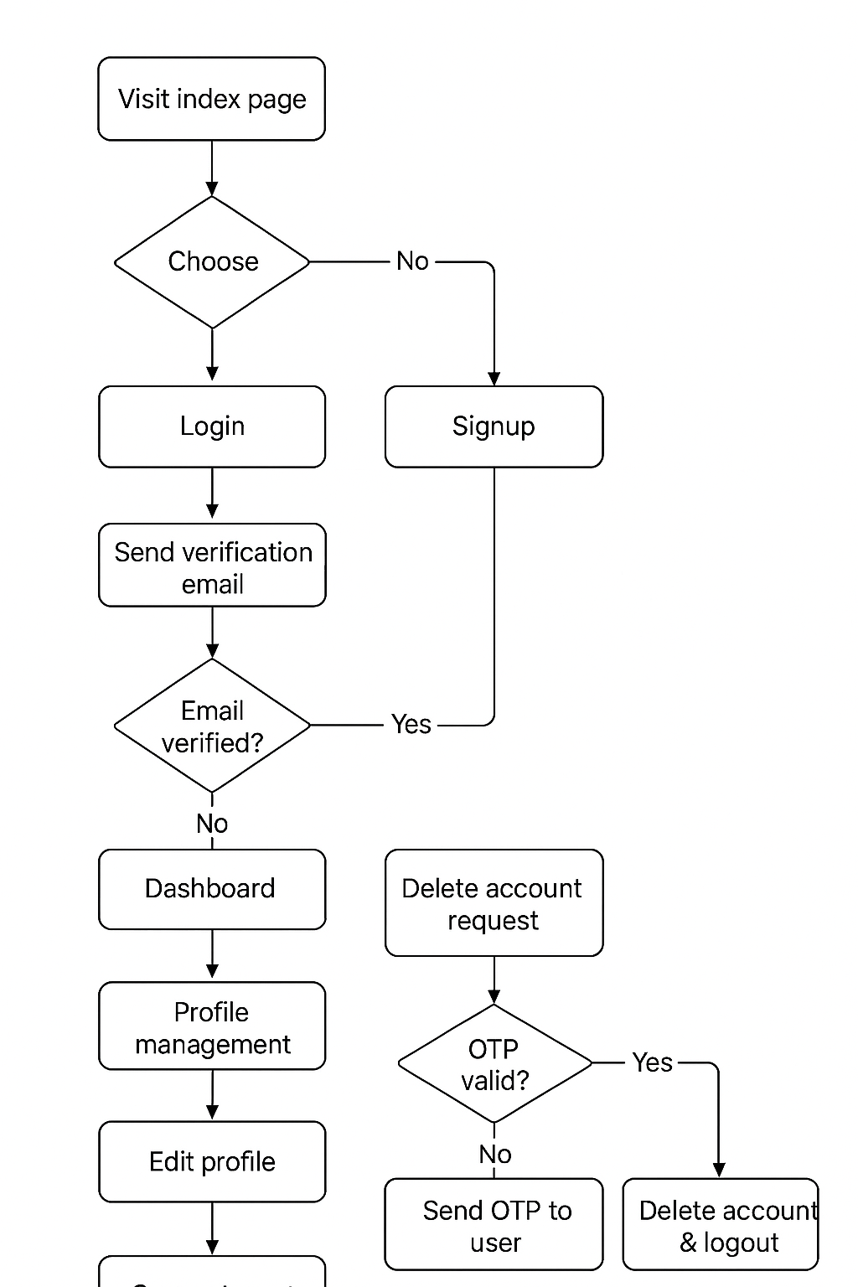
How It Works – User Flow
Visit index page → Login or Signup
Signup → Email verification → Login
Dashboard → Profile management
Delete account with OTP
Secure logout

Slide 7
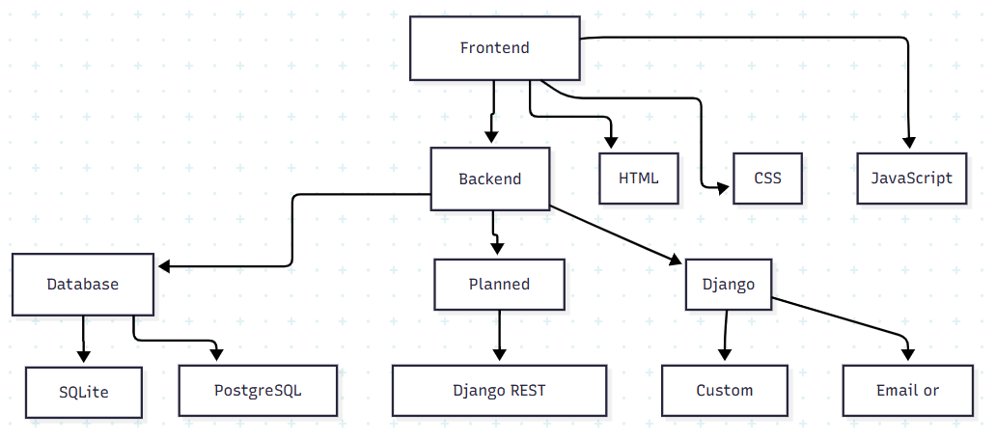
Tech Stack
Frontend: HTML, CSS, JavaScript
Backend: Django (Custom Auth, Email/OTP)
Database: SQLite (dev) → PostgreSQL (prod)
Planned: Django REST Framework for APIs

Slide 8
PROJECT TIMELINE
12 Aug
21 Aug
Present idea & mockups
17 Aug
CRUD operations & API
24 Aug
Frontend & auth completed
Final submission with features

Slide 9
Future Plans
Role-based dashboards (Admin, Teacher, Student)
Institute-wide announcements
Attendance & results module
Public API documentation
Role-based dashboards (Admin, Teacher, Student)
Institute-wide announcements
Attendance & results module
Public API documentation

Slide 10
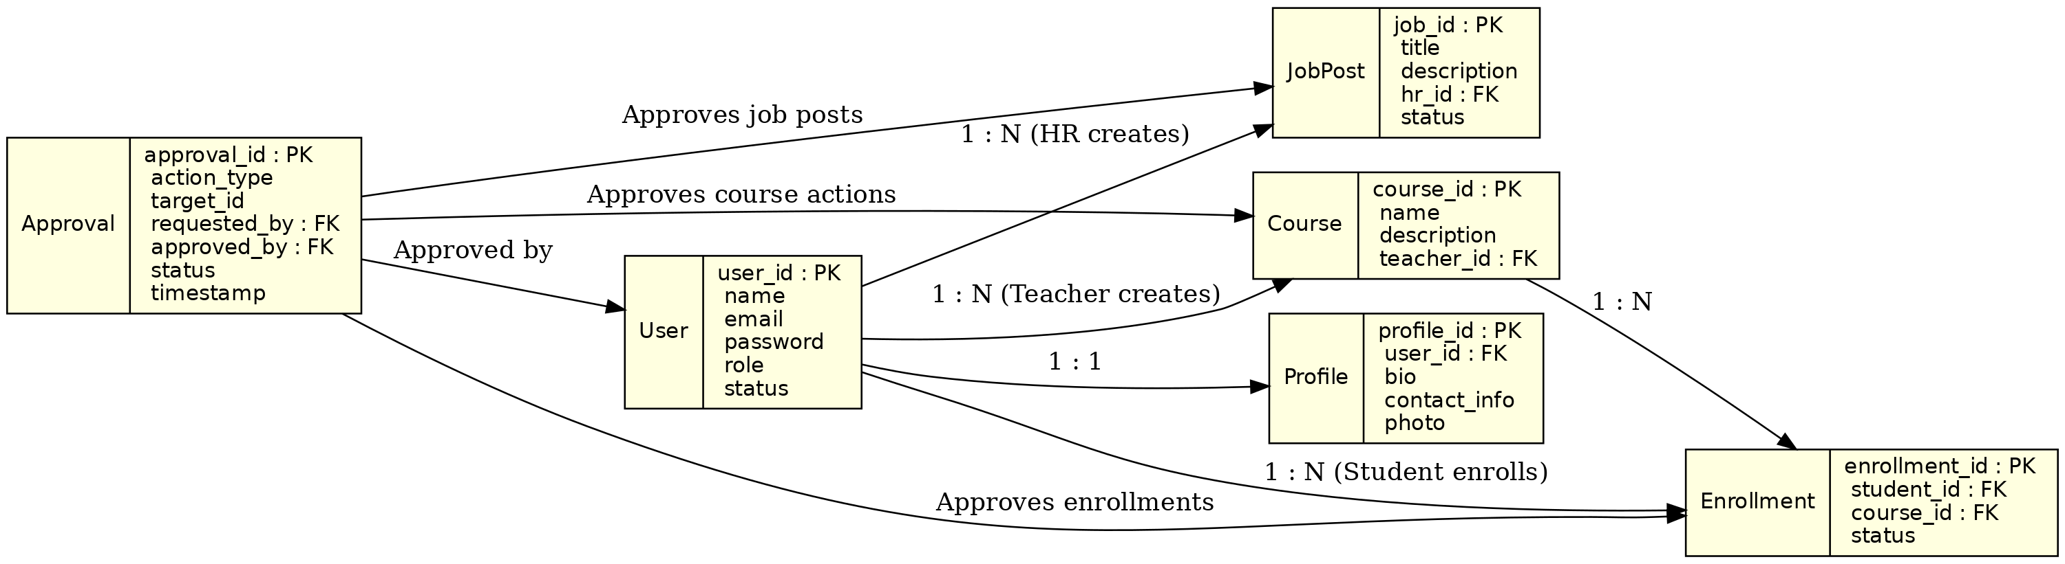
ERD - InstaCore

Slide 11
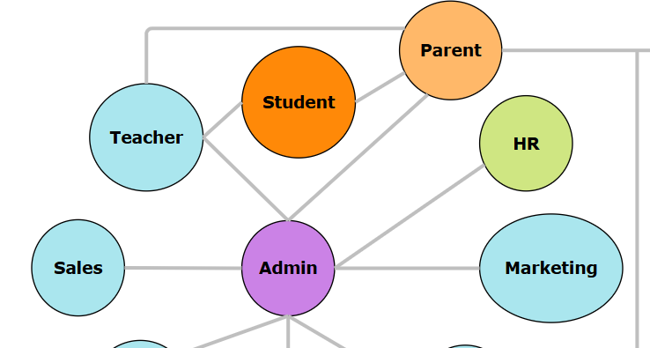
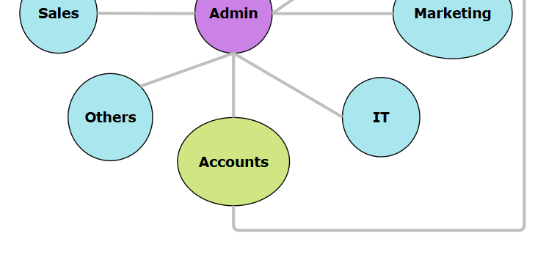
Role Hierarchy

Slide 12
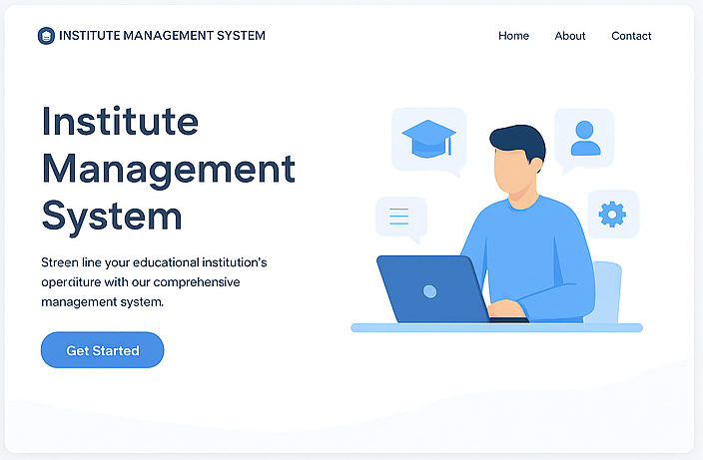
UI Mockups: Landing page

Slide 13
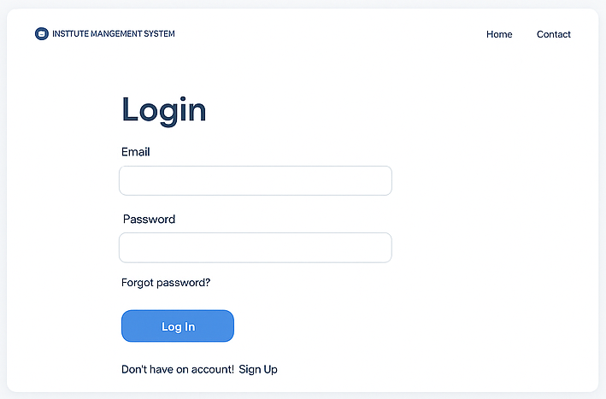
UI Mockups: Login page

Slide 14
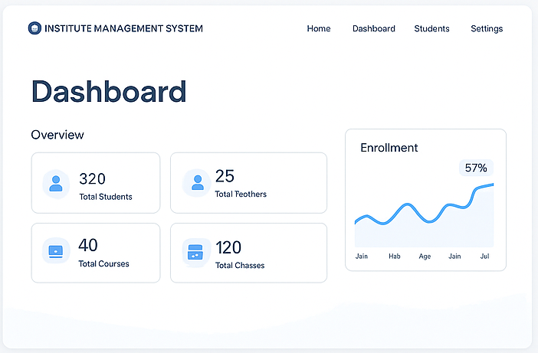
UI Mockups: Dashboard

Slide 15
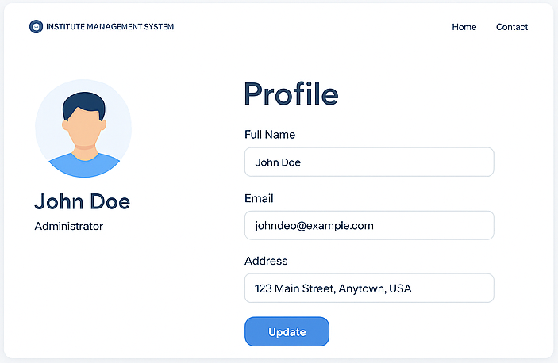
UI Mockups: Profile page

Slide 16
We’re happy
to answer your questions.
Questions?

Slide 17
Thank You
Everyone

